Slide 1
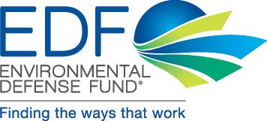
Green Supply Chain
Environmental Defense Fund (EDF)

Slide 2
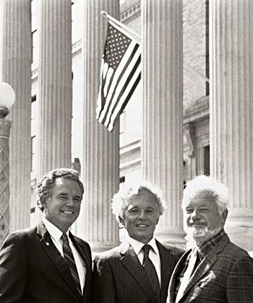
Environmental Defense Fund (EDF)
Leading Non-profit Organization in the U.S.
Established in 1967; Headquartered in New York
Committed to combining scientific and
economic methods to solve the most
pressing environmental problems
Succeeded in:
Promoting the DDT Abolition Act
Convincing McDonald’s to ban Styrofoam
Helping to introduce hybrid trucks to FedEx

Slide 3
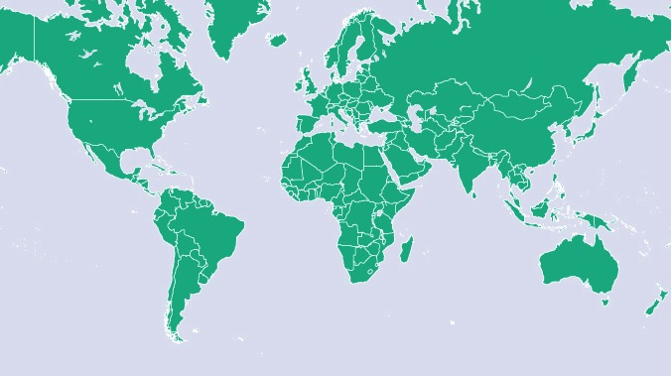
Environmental Defense Fund (EDF)
Annual Budget: $130 Million | Members: 1 Million | Employees: 500 | Offices: 13
Notes:
During the past 30 years, our organization continually growing stronger. Our annual budget has increased from 3 million dollars to 130 million dollars, and our employees have grown from 50 to 500. Our members also have increased from 40,000 to over 1 million. However, I think the most important transformation is that our organization has stepped onto a global platform since the 1980s, from a US domestic organization to an international non-profit with 9 US offices and international offices in Beijing, Shanghai, London, and Mexico.
The EDF's path toward internationalization reflects the changes around the world. With the globalization of information, transportation, and the economy, all of us are now connected to one another. The EDF itself has transformed from a US domestic organization to an international body. We truly believe it is critical to think global and act locally.

Slide 4
Climate
Oceans
Ecology
Health
Notes:
EDF has recognized that the priority problems we focus on – oceans, climate, ecosystems, and health -- transcend national boundaries. These are truly problems of the global commons.

Slide 5
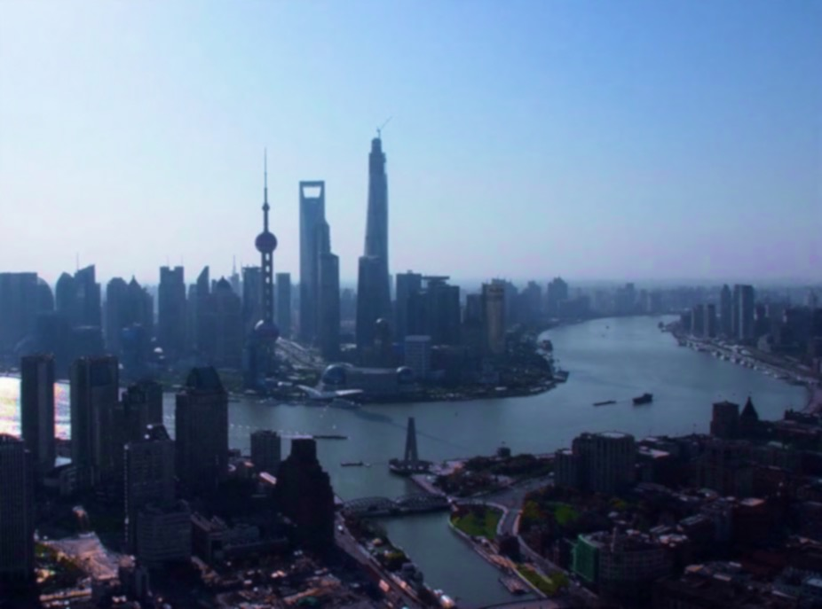
Environmental Defense Fund - China Program
In 1991, the Ministry of Environmental Protection invited EDF to participate in the country’s first experiment using economic incentives in pollution control. Within the next 20 years, EDF implemented its China Program and 6 main projects based on China’s current issues in economic development and environmental protection.
6 Main Projects:
Sulfur Dioxide
Emission Control &
Emissions Trading
Environmental
Law Enforcement
Reducing Greenhouse
Gas Emissions from
Agriculture
Green Supply Chain
Public
Participation
Energy and Power
Sector

Slide 6
Green Supply Chain - Definition
The concept of Green Supply Chain, initially proposed by Michigan State University in 1996, indicates improving the efficiency of resource use throughout the entire supply chain based upon consideration of environmental effects.
Key Stages:
Green Design
Green Materials
Green Manufacturing
Green Logistics
Green Marketing
Green Recycling

Slide 7
Big Data & Supply Chain Management
Information sharing in the supply chain helps:
Reduce inventory cost
Shorten order cycle
Accelerate capital returns
Strengthen adaptability of supply chain
to market conditions
Promote cooperation among suppliers
Purchasers to understand, manage and improve suppliers’ environmental performance
Notes:
Big data is increasingly important in greening supply chain management.
Sharing of information helps buyers and suppliers alike improve environmental performance while reducing cost and increasing returns.

Slide 8
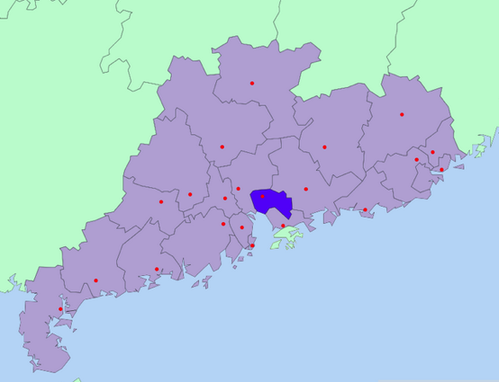
Dongguan
Major Industrial and Manufacturing Center in the Pearl River Delta region
Contains many suppliers of international brands (Apple, Dell, Nike, Wal-Mart, IBM etc.)
Wal-Mart has ~200 suppliers in Dongguan
In 2014, 2/3 of Dongguan’s GDP came from manufacturing and export
Current “Dongguan Mode” :
High energy consumption, pollution, labor density and resource use
Low efficiency
All SMEs
Dongguan, Guangdong Province
Area：4265 km²
Notes:
Our green supply chain work focuses on 3 main regions: Yangtze River Delta, Tianjin-Beijing-Hebei, and the Pearl River Delta.
As a major industrial and manufacturing hub and home to many suppliers of international buyers like Apple and Wal-Mart, Dongguan is key in the Pearl River Delta region.

Slide 9
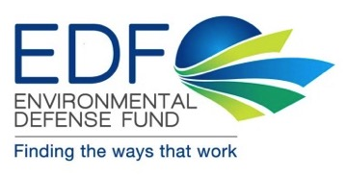
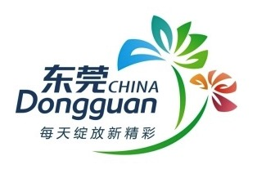
Cooperation with Wal-Mart
Assess supplier energy-saving potential
Build government-firm-NGO cooperation
Wal-Mart has >200 suppliers in Dongguan
Municipal level of Green Supply Chain management
Notes:
An example of the presence of international buyers, Wal-Mart has significant influence with more than 200 suppliers in Dongguan, and is important in leading green procurement and sustainable management practices.
Our cooperation with Wal-Mart and Dongguan aims to implement green supply chain management practices in the corporate and municipal level.

Slide 10
Dongguan Index
Domestic Environmental Legislation
Government Procurement Requirements
International Trade Requirements
Consumer Preferences
Large Buyer
Environment
Energy
Low-Carbon
Secondary Supplier
Tertiary Supplier
…
Supplier
Notes:
The Dongguan Index is a quantitative, holistic, data-driven assessment of environmental performance in the entire supply chain, and consists 3 key aspects of “green”:
Environment
Energy efficiency
Low-carbon development

Slide 11
Aligning Index with Dongguan’s Goals
Dongguan’s ozone concentration is the highest in the Pearl River Delta region
Air quality ranking fell from top 10 in May to #44 in September 2015, mainly due to ozone pollution caused by VOCs emissions from manufacturing
The Dongguan government has made combatting ground-level ozone pollution its top environmental priority
Dongguan Index incorporates Dongguan’s effort in ozone control and VOCs emission reduction to aim for a 6% decrease in ozone concentration by the end of 2016 compared to that of 2014, and 80% daily compliance rate;
6% further decrease in ozone concentration and 85% daily compliance rate by the end of 2017, and through 3 years of combined effort, significantly improve air quality in Dongguan.
Through comparing scales, employee populations, export volumes, and environmental impact of different industries, Dongguan Index targets the shoe and furniture manufacturing industries for maximum incentive.

Slide 12
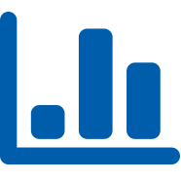
What Makes Dongguan Index Unique?
Entire supply chain assessment
Holistic performance measurement
Assessment of the degree of greening
Technical advantage
Broad functionality

Slide 13
1. Entire Supply Chain Evaluation
Precedent: Dow Jones Sustainability Index (DJSI)
Assesses a company’s sustainability performance based on economic, social and environmental indicators
Specifications only involves primary suppliers
Environmental chapter does not account for the supply chain
Dongguan Index assesses performance of both individual large buyers and their upstream suppliers, promoting the greening of the entire supply chain in a step-by-step process.
Notes:
The DJSI Index’s specifications only involve primary suppliers, which are more accessible to buyers but generally have smaller environmental impact than secondary materials suppliers
Its environmental chapter includes assessment criteria for environmental reporting, management, GHG emissions, water usage and waste production, but does not account for the supply chain

Slide 14
2. Holistic Performance Measurement
Dongguan Index holistically measures a supply chain’s environmental performance based on 3 key aspects:
Energy efficiency
Environment
Low-carbon development
Each aspect includes:
Basic – compliance to laws and regulations
Improvement – voluntary actions on improving environmental performance
The Dongguan Index incorporates 3 important aspects and weighs different metrics in assessing environmental performance.
Notes:
The index is based on a holistic performance assessment criteria consisting 3 key aspects: energy efficiency, environment, low-carbon development
Each aspect includes 2 types of indicators:
Basic – includes compliance to environmental laws and regulations
Improvement – reflects voluntary actions on improving environmental performance

Slide 15
Dongguan Index
Environmental
Basic
Improvement
Energy
Basic
Low-Carbon
Improvement
Basic
Improvement
Compliance
Clean Production
…
Environmental Investment
Monitoring Automation
…
Statistics and Measurements
Elimination of Outdated Production
…
Management System
Energy Efficiency Projects
…
Carbon Trading
…
Solar PV
Biofuels Use
…
Notes:
Index Structure: 3 aspects total with 2 types of specifications in each aspect

Slide 16
3. Assessment of the Degree of Greening
Dongguan Index provides not only a score, but also improvement recommendations for all relevant parties, expanding functionality and applicability.
Companies can determine which areas to improve based on their score, and effectively allocate resources.

Slide 17
4. Technical Advantage
Index | Focus | Limitations compared to Dongguan Index
CITI Index | Environmental management in supply chains | General and qualitative criteria (Eg. “Encourage Suppliers to Disclose Self-operated Monitoring Data”)
Global Reporting Initiative Index (GRI) | Supply chain reporting | Lack of focus on environmental performance (<6% of total specifications)
Climate Disclosure Leaders Index (CDP) | Supply chain environmental disclosure | Limited topics (only GHG emissions and water and forest resources)
The Walmart Sustainability Index by The Sustainability Consortium (TSC) | Supply chain sustainability throughout whole product life cycles | Mainly based on multiple-choice surveys of suppliers; may be more subjective
RedE | Supply chain energy saving | Sole focus on energy efficiency
Notes:
1. The CITI Index assesses the effectiveness of environmental management measures in supply chains. However, its criteria is too general and rely on closed-ended questions for points
2. 2 out of 149 (which is less than 6%) of specifications in GRI are related to environmental performance, and is not sufficient to motivate large buyers to implement projects to address problems in their supply chains.
3. Although CDP accounts for the supply chain, its environmental topics are limited to GHG emissions and water and forest resources, hindering its efforts to address air and water pollution in China.
4. The Walmart Sustainability Index by TSC measures supplier sustainability performance throughout their whole product life cycles using KPI surveys. Although shifting toward more quantitative KPIs, the majority of questionnaires are still qualitative and multiple-choice, and may lead to more subjective results
5. RedE (Resource Efficiency Deployment Engine) is a web-based tool developed by McKinsey & Co. to help clients scope energy saving opportunities and select energy efficiency projects for their suppliers through financial analysis. Compared to Dongguan Index, its sole focus is on energy efficiency.

Slide 18
5. Broad Functionality
Dongguan Index is useful and applicable for all relevant parties.
Users include:
1. Suppliers: identify problems in all 3 aspects of energy, environment, and low-carbon development and clarify improvement areas through benchmarking.
2. Large buyers: prioritize potential partners with high scores and promote corrective action and green procurement throughout the entire supply chain.
3. Governments: better understand the degree of greening in different industries, and utilize replicable, scalable green supply chain management methods for urban and industrial planning and ecological civilization establishment.
4. Regulation agencies: realize issues in environmental compliance standards, further guide compliance and risk management, and use the index as a prerequisite for government subsidy and tax breaks.
5. Financial institutions: incorporate the index as a component in credit evaluation for financing.
Notes:
Dongguan Index is widely applicable. Its broad range of users include:
Suppliers; they can identify problems and improvement areas in all 3 aspects of environmental performance
Buyers: they can use the index as a form of due diligence to evaluate potential partners, promote corrective action in existing suppliers, and practice green procurement throughout
Governments: can better understand greening differences in different industries, and identify replicable, scalable GSC management best practices for urban and industrial planning, and establishing ecological civilization
Regulation agencies: can realize issues or shortcomings in environmental compliance standards, provide further guidance in compliance and risk management, and reference the index for subsidies and tax breaks
Financial institutions: can incorporate the index as a component in a firm’s credit evaluation for financing

Slide 19
Thank you!

