Slide 1
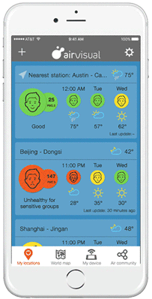
The Air Quality Community

Slide 2
Technology enables
new approaches to air quality control
Artificial
Intelligence
Laser
technology
Big Data
Internet
of Things
Cloud&Mobile
computing

Slide 3
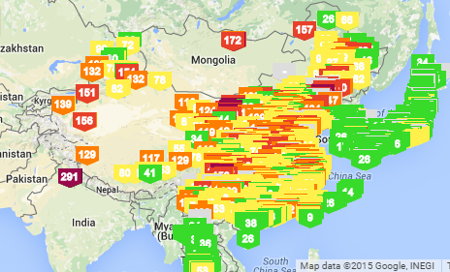
Our mission is to monitor
and inform
6,000 cities monitored worldwide
30 countries
processing 100 million data points a day
providing historical, current and forecast AQ data
information on air pollution
iOS + Android + Website

Slide 4
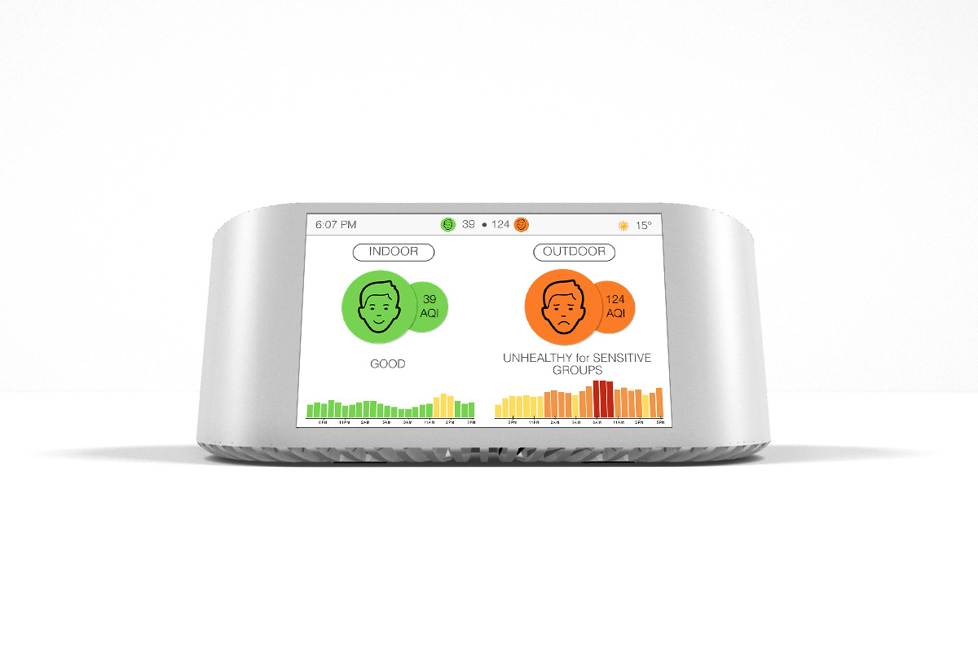
World’s smartest air quality sensor
Real-time sensor calibration
based on external factors (temperature, humidity, pressure)
Smart data correction
machine learning algorithms remove data outliers
High precision technology
cutting edge laser and optics sensor
Quad-core CPU chip
for advanced signal processing
Airflow control
constant intake of the air and particles

Slide 5
Accuracy
that we never knew was possible until now

Slide 6
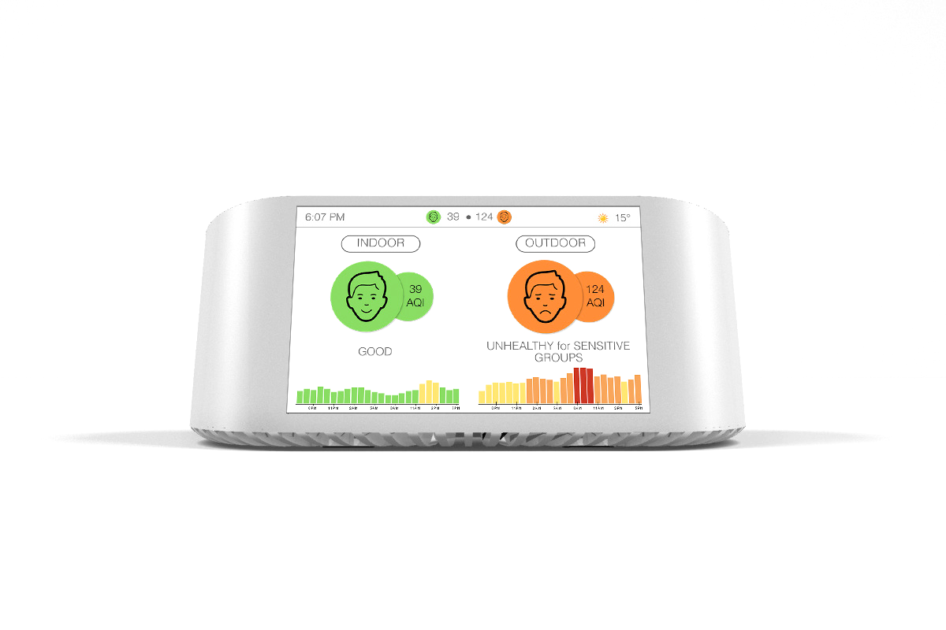
Integrated platform
HVAC
Government
stations
Outdoor/indoor
AirVisual Node

Slide 7
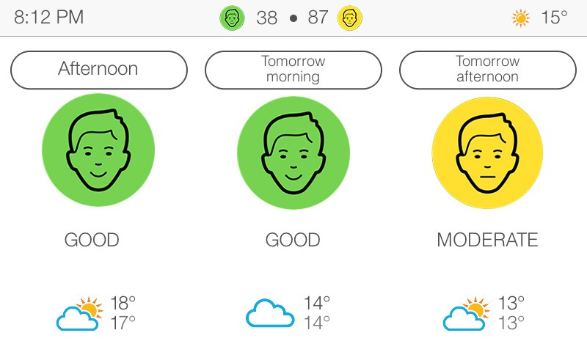
AirVisual Forecasts
Based on machine learning
Historical data
Global Forecast System
air quality
forecast
Data patterns
Global monitoring system
of air pollution
Self-learning
model
Spectrometry images
Station’s data

Slide 8
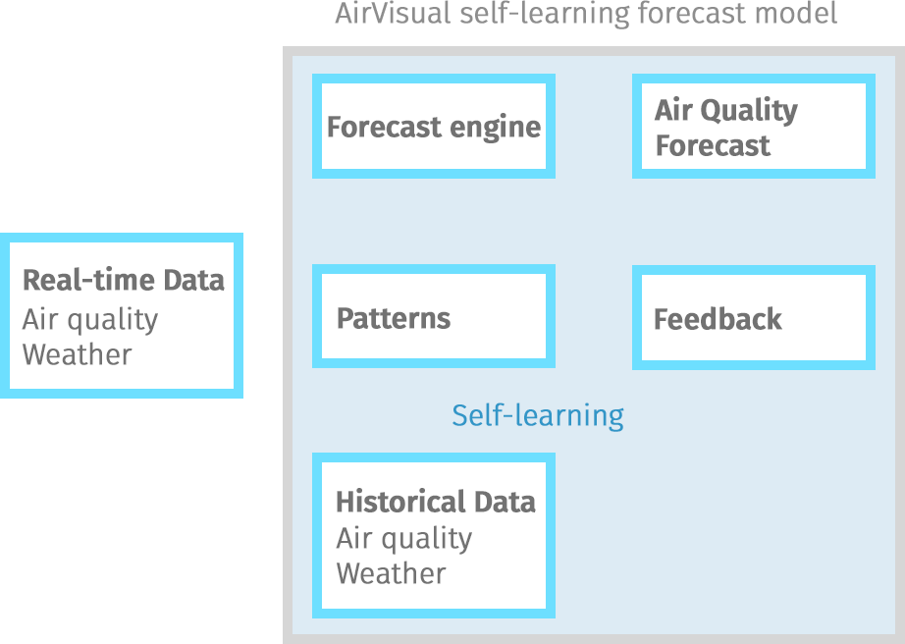
Forecast
model

Slide 9
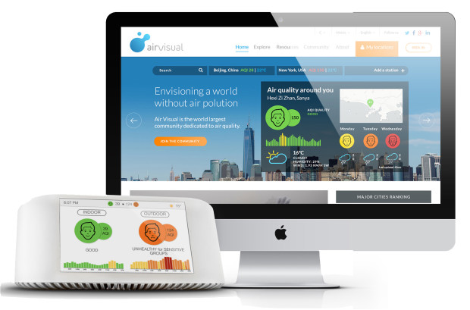
Big data for the people of the world

Slide 10
The Air Quality Community

